Slide 1
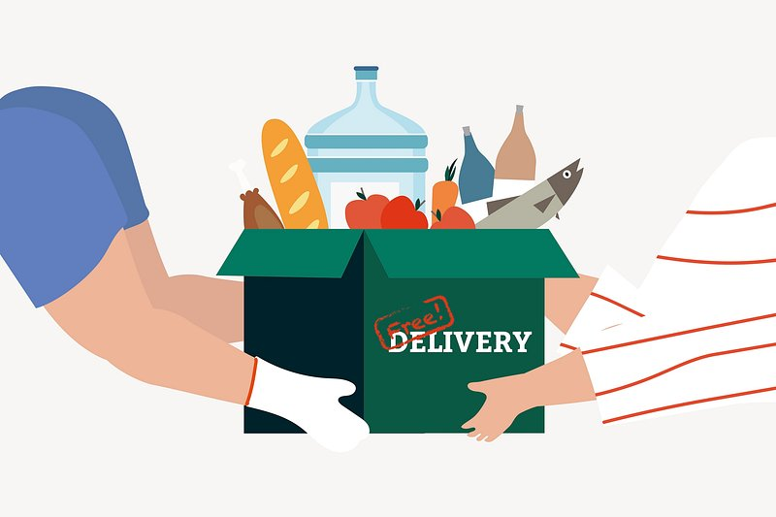
Food Delivery Operations & Performance Analysis Using SQL
1
Presented BY:
Vibha Tele
Harshini Nawale
SQL-Based Business Analytics Project

Slide 2
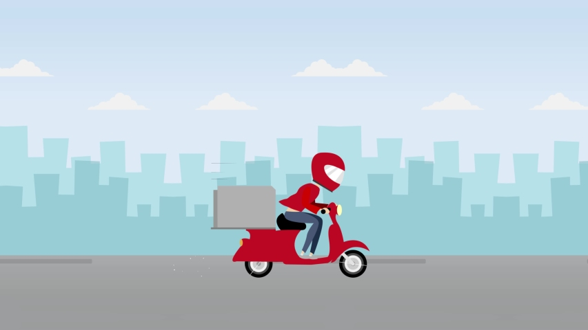
2
Business scenario
A food delivery company operating across Metropolitan, Urban, and Semi-Urban cities was facing delivery delays, operational inefficiencies, and inconsistent delivery performance. The company wanted to identify the major factors affecting delivery efficiency and optimize operations using data analytics.

Slide 3

AIM AND OBJECTIVES OF PROJECT
3
AIM :To analyze food delivery operations using SQL and identify operational factors affecting delivery efficiency, customer satisfaction, and delivery performance.
5.Analyze vehicle efficiency
6.Study customer ordering behavior
7.Identify operational risk
8.suggest business improvements
1. Analyze delivery delays
2.Evaluate driver performance
3.Study traffic impact
4.Analyze weather impact

Slide 4

Dataset Overview
Table 2- Delivery Location
4
Column Name | Constraint | Data-type
Location_ID | Primary Key | Varchar(10)
Order_ID | Not Null | INT
Delivery_location_latitude | CHECK (1–5) | Decimal(2,1)
Delivery_location_longitude | CHECK (0–3) | TINYINT
city | Not Null | Varchar(30)
Table 1- Delivery Person
Column Name | Constraint | Data-type
Delivery_person_ID | Primary Key | Varchar(10)
Delivery_person_Age | Not Null | INT
Delivery_person_Ratings | CHECK (1–5) | Decimal(2,1)
Vehicle_condition | CHECK (0–3) | TINYINT
Type_of_vehicle | Not Null | Varchar(30)
City | Not Null | Varchar(20)
Table 3- Restaurants
Column Name | Data-type | Constraint
Restaurant_id | INT | Primary Key
Restaurant_lattitude | Decimal(8,5) | -
Restaurant_longitude | Decimal(8,5) | -
City_type | Varchar(20) | -

Slide 5

Table 4 - Orders
5
Column Name | Data-type | Constraint
Order_id | Varchar(10) | Primary_key
Delivery_person_id | Varchar(10) | Fk_delivery_person
Restaurant_id | INT | Fk_restaurants
Order_Date | Date | -
Time_ordered | Time | -
Time_ordere_picked | Time | -
Type_of_order | Varchar(20) | -
Multiple_deliveries | TINYINT | -
Festival | Varchar(10) | -
Weather_conditions | Varchar(20) | -
Road_traffic_density | Varchar(20) | -
Delivery_time | INT | -

Slide 6
Food Delivery Performance Analysis
6
A) Basic KPIs Analysis
1.Total Orders analysis
2.Average Delivery Time
3.Average Delivery Person Rating
F) Driver Performance Analysis
Top Performing Delivery Agent
Driver Ranking Analysis
K)Time- Based Analysis
-Peak Delivery Delay Timings
G) & H) Windows Function & Subquery Analysis
Driver Ranking Using Rank
Driver Performance better than overall Average
B) Traffic Analysis
Traffic Density Vs Delivery Time
L)Delay risk Analysis
1.Weather + Traffic Combination Impact
2.Multiple Deliveries During Jam Traffic
C)Weather Analysis
Weather condition Vs Delivery Time
I)Vehicle Performance Analysis
1.Fastest Vehicle Type
2.Vehicle Condition Impact
3.Vehicle Ranking Analysis
D) Multiple Delivery Analysis
Weather condition Vs Delivery Time
M) Location& Delivery &Coverage Analysis
Restaurant Distribution by city type
2.Delivery Location Distribution
J)Order Type Analysis
1.Delivery Time by Order Type
2.Most Frequently Ordered Category
E)City Performance Analysis
Delivery Time Across Different City

Slide 7
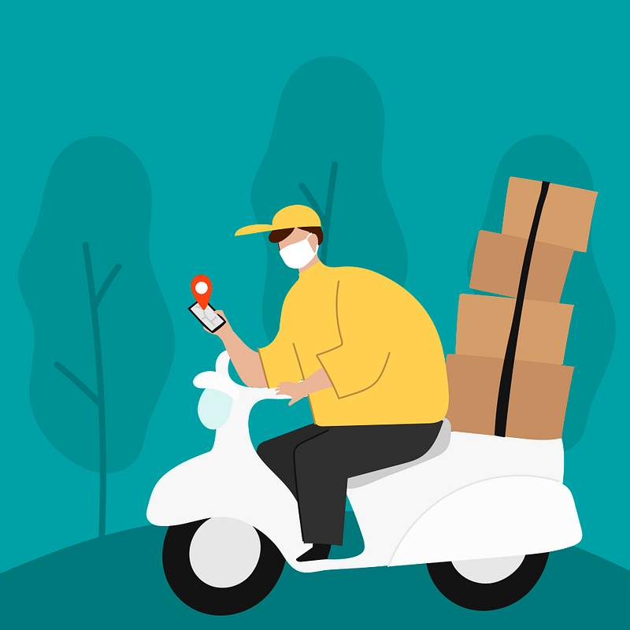
BASIC KPIs
7
Average delivery Time
Average Delivery Person Rating
Total Orders
SELECT COUNT(*) AS TOTAL_ORDERS
FROM ORDERS;
SELECT AVG(DELIVERY_PERSON_RATINGS) AS AVG_RATING
FROM DELIVERY_PERSON;
SELECT AVG(DELIVERY_TIME) AS AVG_DELIVERY_TIME
FROM ORDERS;
50
4.5840
34.1200 min

Slide 8

B) TRAFFIC ANALYSIS
C) WEATHER ANALYSIS
8
BUSINESS Problem -Does traffic density affect delivery time?
BUSINESS Problem –which weather condition affects most food delivery time.
Road Traffic Density | AVG Delivery Time (min)
High | 44.6000
Jam | 41.0000
Medium | 33.5000
Low | 21.8667
Weather condition | AVG Delivery Time (min)
Stormy | 46.1167
Sandstorms | 41.2000
cloudy | 35.8571
FINDING- High traffic density shows the highest average delivery time.
BUSINESS INSIGHT- Traffic congestion is one of the major causes of delayed food delivery operations.
BUSINESS SOLUTION-
The company should implement smart route optimization and increase delivery staffing during peak traffic hours.
FINDING-Stormy weather has the highest average delivery time.
BUSINESS INSIGHT - Stormy weather negatively affects delivery efficiency and increases delays.
BUSINESS SOLUTION - Implement weather-based route optimization and dynamic ETA prediction to reduce delays during adverse weather conditions.

Slide 9
D) MULTIPLE DELIVERY ANALYSIS
E) CITY PERFORMACE
9
Business Problem - impact of multiple deliveries on delivery time?
Business Problem – what is delivery performance across different city types?
Multiple Deliveries | AVG Delivery Time (min)
1 | 35.5357
0 | 30.8947
2 | 36.0000
3 | 52.0000
City | AVG Delivery Time (min)
Metropolitan | 35.5625
Urban | 30.8000
Semi-urban | 35.3333
FINDING- Orders with 3 multiple deliveries have the highest average delivery time, and delivery time decreases as the number of deliveries decreases
BUSINESS INSIGHT- Handling multiple orders simultaneously increases delivery delays and reduces operational efficiency
BUSINESS SOLUTION- Limit multiple deliveries during peak hours and optimize delivery allocation to reduce delays
FINDING-Metropolitan cities have the highest average delivery time, followed by Semi-Urban and Urban cities
BUSINESS INSIGHT - High traffic and operational complexity in metropolitan areas lead to longer delivery times.
BUSINESS SOLUTION - Improve route optimization and increase delivery resources in metropolitan cities to reduce delays and improve efficiency.

Slide 10
F) DRIVER PERFORMANCE ANALYSIS
G) Ranking Driver (Windows Function)
10
Business Problem -Identify top-performing delivery agents based on delivery efficiency
Business Problem –Rank delivery agents based on delivery performance
Delivery Person Id | AVG Delivery Time
AB13 | 18.0000
AB44 | 18.0000
AB14 | 19.0000
AB30 | 19.0000
AB07 | 20.0000
Delivery Person Id | Ranking
AB13 | 1
AB44 | 1
AB14 | 3
AB30 | 3
AB33 | 5
FINDING- Delivery agents AB13, AB44, AB14, AB30, and AB33 have the shortest average delivery time.
BUSINESS INSIGHT- Efficient delivery agents help reduce delivery delays and improve operational performance.
BUSINESS SOLUTION- Analyze the working patterns of top-performing drivers and use them as benchmarks for training other
FINDING-Delivery agents AB13 and AB44 achieved Rank 1, followed by AB14, AB30, and AB33 among the top-performing drivers based on average delivery time
BUSINESS INSIGHT - Top-ranked delivery agents demonstrate higher delivery efficiency and faster order completion
BUSINESS SOLUION - Use performance ranking to identify efficient drivers, improve workforce management, and provide training based on top performers’ delivery practices.

Slide 11
H) SUBQUERY ANALYSIS
11
I) VEHICLE PERFORMACE ANALYSIS
Business Problem -Identify delivery agents performing better than the overall average delivery time.
Business Problem –1)Which vehicle type delivers fastest?
Delivery Person Id | AVG Delivery Time
AB13 | 18.0000
AB14 | 19.0000
AB07 | 20.0000
AB32 | 21.0000
AB29 | 22.0000
Type of Vehicle | AVG Delivery Time (min)
Electric Scooter | 37.0000
Motorcycle | 35.7308
Scotter | 31.4500
FINDING- Delivery agents AB13, AB14, AB07, AB032, AB29 performed better than the average delivery time.
BUSINESS INSIGHT- Some delivery agents consistently deliver orders faster than the overall operational average, indicating higher efficiency
BUSINESS SOLUTION- Recognize high-performing delivery agents and use their delivery practices as performance benchmarks for improving overall delivery efficiency.
FINDING-Electric scooters have the highest average delivery time, while scooters show the lowest average delivery time.
BUSINESS INSIGHT - Vehicle type affects delivery efficiency, and scooters perform better for faster food delivery operations
BUSINESS SOLUTION - Increase scooter allocation for short-distance deliveries and optimize vehicle assignment based on delivery conditions and city routes

Slide 12
I) VEHICLE PERFORMACE ANALYSIS
I) VEHICLE PERFORMACE ANALYSIS
12
Business Problem -2)Does vehicle condition affect delivery efficiency?
Business Problem –3) Which vehicle type performs best in metropolitan cities?
Vehicle Condition | AVG Delivery Time
3 | 42.0000
0 | 30.6875
1 | 33.1429
2 | 33.9474
Type of Vehicle | AVG Delivery Time (min)
Electric Scooter | 40.0000
Motorcycle | 36.5789
Scotter | 33.0000
FINDING- Vehicle condition 3 has the highest average delivery time, while vehicle condition 1 shows the lowest average delivery time
BUSINESS INSIGHT-
Poor or unsuitable vehicle conditions can reduce delivery efficiency and increase delivery delays
BUSINESS SOLUTION- Regular vehicle maintenance and proper vehicle allocation should be implemented to improve delivery performance and reduce operational delays
FINDING-Electric scooters have the highest average delivery time in metropolitan cities, while scooters show the lowest average delivery time
BUSINESS INSIGHT - Scooters perform more efficiently in metropolitan areas with high traffic and shorter delivery routes
BUSINESS SOLUTION - Increase scooter allocation in metropolitan cities and optimize vehicle selection based on traffic and route conditions to improve delivery efficiency

Slide 13
J) Order Type Analysis
13
Business Problem - 1)Which order type takes longest delivery time? / Analyze delivery performance across different order types.
Business Problem –2) Which order type is most frequently ordered? / Identify the most frequently ordered food categories
Type of Order | AVG Delivery Time
Buffet | 36.6000
Drinks | 35.0000
Meal | 33.
Snacks | 33.9474
Type of Order | Total orders
Snacks | 14
Meal | 14
Drinks | 12
Buffet | 10
FINDING- Buffet orders have the highest average delivery time, while snack orders have the lowest average delivery time
BUSINESS INSIGHT-Larger or more complex food orders like buffet meals may require additional preparation and handling time, leading to delivery delays
BUSINESS SOLUTION- Implement better order preparation coordination and assign experienced delivery agents for large buffet orders to improve delivery efficiency
FINDING-Snack and Meal orders are the most frequently placed order types, followed by Drinks orders.
BUSINESS INSIGHT - Customers show higher demand for quick meals and snack items, making them the core revenue-driving order categories
BUSINESS SOLUTION -Improve operational planning and inventory management for high-demand meal and snack categories to ensure faster service and better customer satisfaction.

Slide 14
k) TIME-BASED ANALYSIS
14
Business Problem - 1) Which order time has highest delivery time? /Analyze delivery performance based on order timing to identify peak delay periods.
Time_ordered | AVG Delivery time
11:10:10 | 52.0000
19:35:00 | 48.0000
19:15:00 | 47.0000
11:20:00 | 47.0000
21:20:00 | 47.0000
FINDING- Orders placed during afternoon and evening hours, especially around 7 PM to 9 PM, show the highest average delivery times. The highest delay was observed at 11:10 PM and 7:35 PM.
BUSINESS INSIGHT-Peak order timings increase operational pressure, traffic congestion, and restaurant preparation load, leading to longer delivery times
BUSINESS SOLUTION- Increase delivery staff and optimize order allocation during peak evening hours to reduce delays and improve delivery efficiency

Slide 15
L)Delay Risk Analysis
15
Business Problem - 1)Which weather and traffic combination causes highest delays? / Identify which weather and traffic combinations create the highest delivery delays.
Business Problem –Do multiple deliveries during jam traffic increase delays? /Analyze whether multiple deliveries during jam traffic increase delivery delays.
Weather condition | Road Traffic Density | AVG Delivery time
Sandstorm | jam | 47.0000
Stormy | jam | 47.0000
Stormy | High | 45.3333
Windy | High | 43.5000
Sandstorms | Medium | 43.0000
Multiple deliveries | AVG Delivery Time
1 | 41.1429
0 | 40.6667
FINDING-Orders with 1 multiple delivery show slightly higher average delivery time compared to orders with no multiple deliveries during jam traffic
BUSINESS INSIGHT - Assigning multiple deliveries to delivery agents during heavy traffic conditions can increase operational delays and reduce delivery efficiency
BUSINESS SOLUTION -Limit multiple order assignments during jam traffic and optimize delivery allocation to improve delivery speed and customer satisfaction.
FINDING- Stormy and Sandstorm weather conditions combined with Jam traffic show the highest average delivery times, while Sunny and Low traffic conditions show the lowest delays
BUSINESS INSIGHT-Severe weather conditions along with heavy traffic significantly increase delivery delays and operational risk.
BUSINESS SOLUTION-
Implement dynamic delivery planning during adverse weather conditions by increasing delivery resources, optimizing routes, and improving ETA prediction for customers.

Slide 16
M) LOCATION AND DELIVERY COVERAGE ANALYSIS
16
Business Problem -1) Which City Has More Restaurants?
Which City Has More Delivery Locations? / Analyze customer delivery distribution across different city types.
City | Max Location
Metropolitan | 32
Urban | 15
Semi – Urban | 3
City Type | Total Restaurants
Metropolitan | 35
Urban | 15
FINDING- Metropolitan cities have significantly more restaurants compared to Urban cities.
BUSINESS INSIGHT- The company’s operations and restaurant partnerships are highly concentrated in metropolitan areas, indicating higher customer demand and business activity in these regions.
BUSINESS SOLUTION-Expand restaurant partnerships in Urban cities to increase market reach and balance delivery operations across different locations.
FINDING-Metropolitan cities have the highest number of delivery locations, followed by Urban cities, while Semi-Urban cities have the lowest delivery coverage.
BUSINESS INSIGHT -Customer demand and delivery operations are highly concentrated in metropolitan areas, whereas Semi-Urban regions show lower operational reach and market penetration
BUSINESS SOLUTION - Increase delivery expansion and promotional activities in Semi-Urban and Urban areas to improve customer reach and business growth.

Slide 17
Conclusion
Conclusion
The SQL-based analysis identified the major factors affecting food delivery performance.
Traffic congestion, bad weather, peak evening hours, and multiple deliveries caused the highest delays.
Metropolitan cities showed the highest operational pressure and delivery time.
Scooters performed more efficiently, while top delivery agents achieved faster delivery performance.
Meal and snack orders showed the highest customer demand, whereas buffet orders required more delivery time.
Overall, the project demonstrated how SQL analytics can help improve route optimization, delivery planning, operational efficiency, and customer satisfaction through data-driven decision-making.

